Slide 1
St. Louis Central Corridor West Building Permits
Quarter 2 Report: 2020

Slide 2
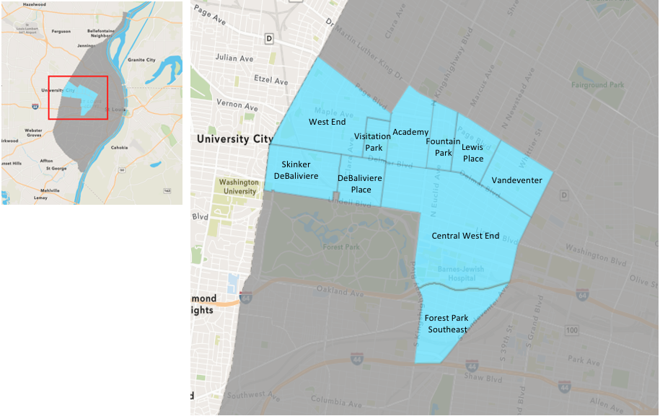
St. Louis Neighborhood Spatial Reference

Slide 3
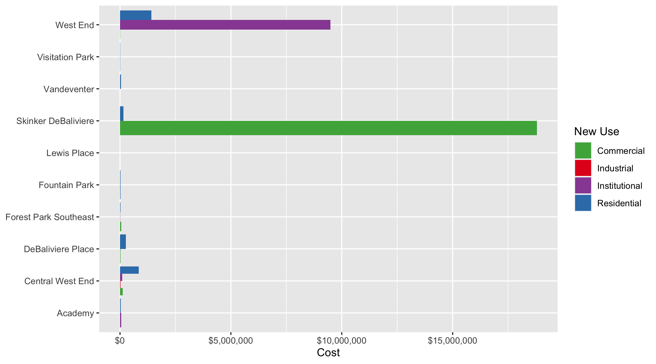
Neighborhood Summary: Average Building Permit Cost

Slide 4
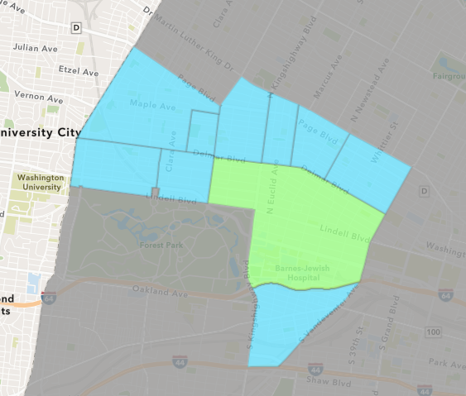
Central West End
Quarter 2 , 2020 Neighborhood Cost Breakdown
Mean: $512,982
Median: $22,218
Range: $200 - $40,000,000

Slide 5
Central West End: Summary Notes
91 building permits in Quarter 2, 2020
-11.65% change compared to Quarter 2, 2019 (103 total building permits)
$512,982: Average building permit cost in Quarter 2, 2020
57.20% change compared to Quarter 2, 2019 ($326,323)

Slide 6
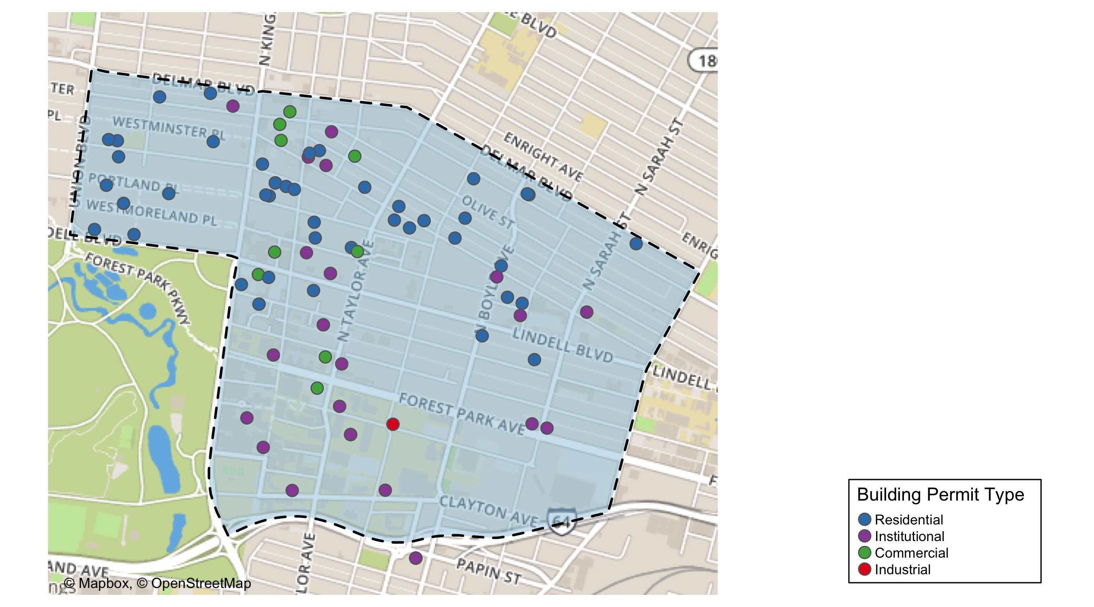
Central West End

Slide 7
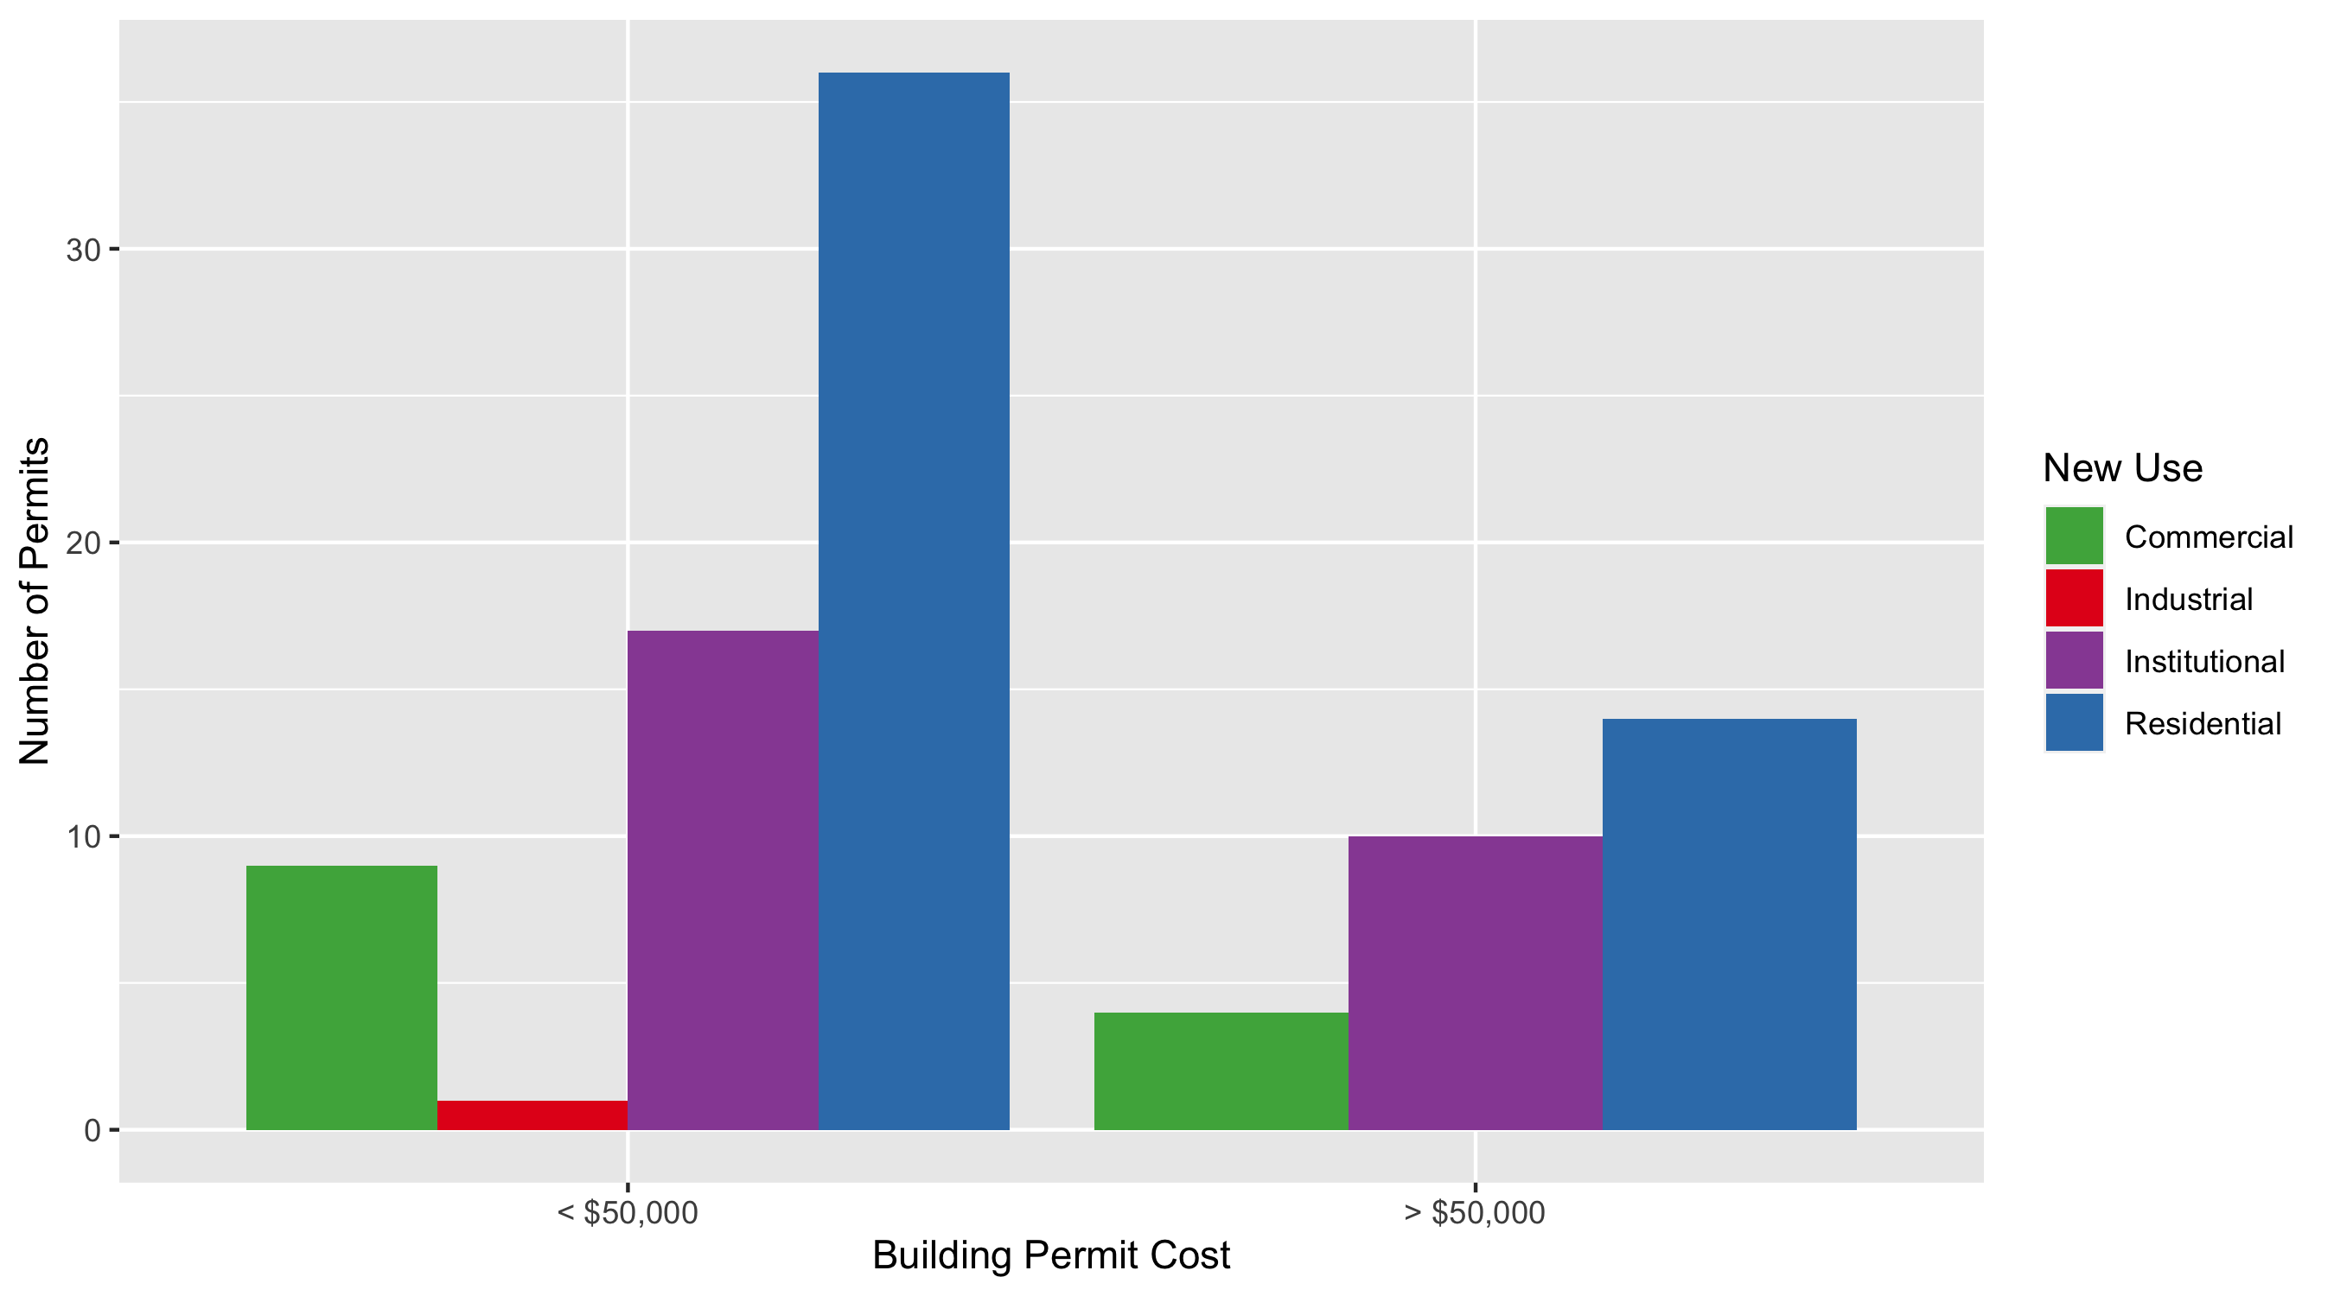
Central West End Permit Use Breakdown

Slide 8
Central West End
Quarter 2, 2020 | Quarter 2, 2020 | Quarter 2, 2020 | Quarter 2, 2020
Permit Use | Average Cost | # of Permits | Total Value of Permits
Commercial | $137,595 | 13 | $1,788,739
Industrial | $20,000 | 1 | $20,000
Institutional | $103,933 | 27 | $2,806,203
Residential | $841,329 | 50 | $42,066,442
Quarter 2 2019 | Quarter 2 2019 | Quarter 2 2019 | Quarter 2 2019
Permit Use | Average Cost | # of Permits | Total Value of Permits
Commercial | $346,386 | 21 | $7,274,104
Industrial | $0 | 0 | $0
Institutional | $641,004 | 37 | $23,717,142
Residential | $58,222 | 45 | $2,619,977

Slide 9
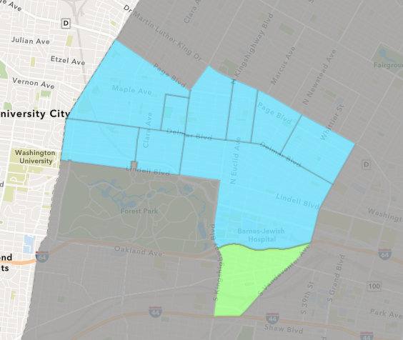
Forest Park Southeast
Quarter 2 , 2020 Neighborhood Cost Breakdown
Mean: $29,424
Median: $7,700
Range: $50 - $169,955

Slide 10
Forest Park Southeast: Summary Notes
27 building permits in Quarter 2, 2020
-22.86% change compared to Quarter 2, 2019 (35 total building permits)
$29,424: Average building permit cost in Quarter 2, 2020
-41.40% change compared to Quarter 2, 2019 ($50,212)

Slide 11
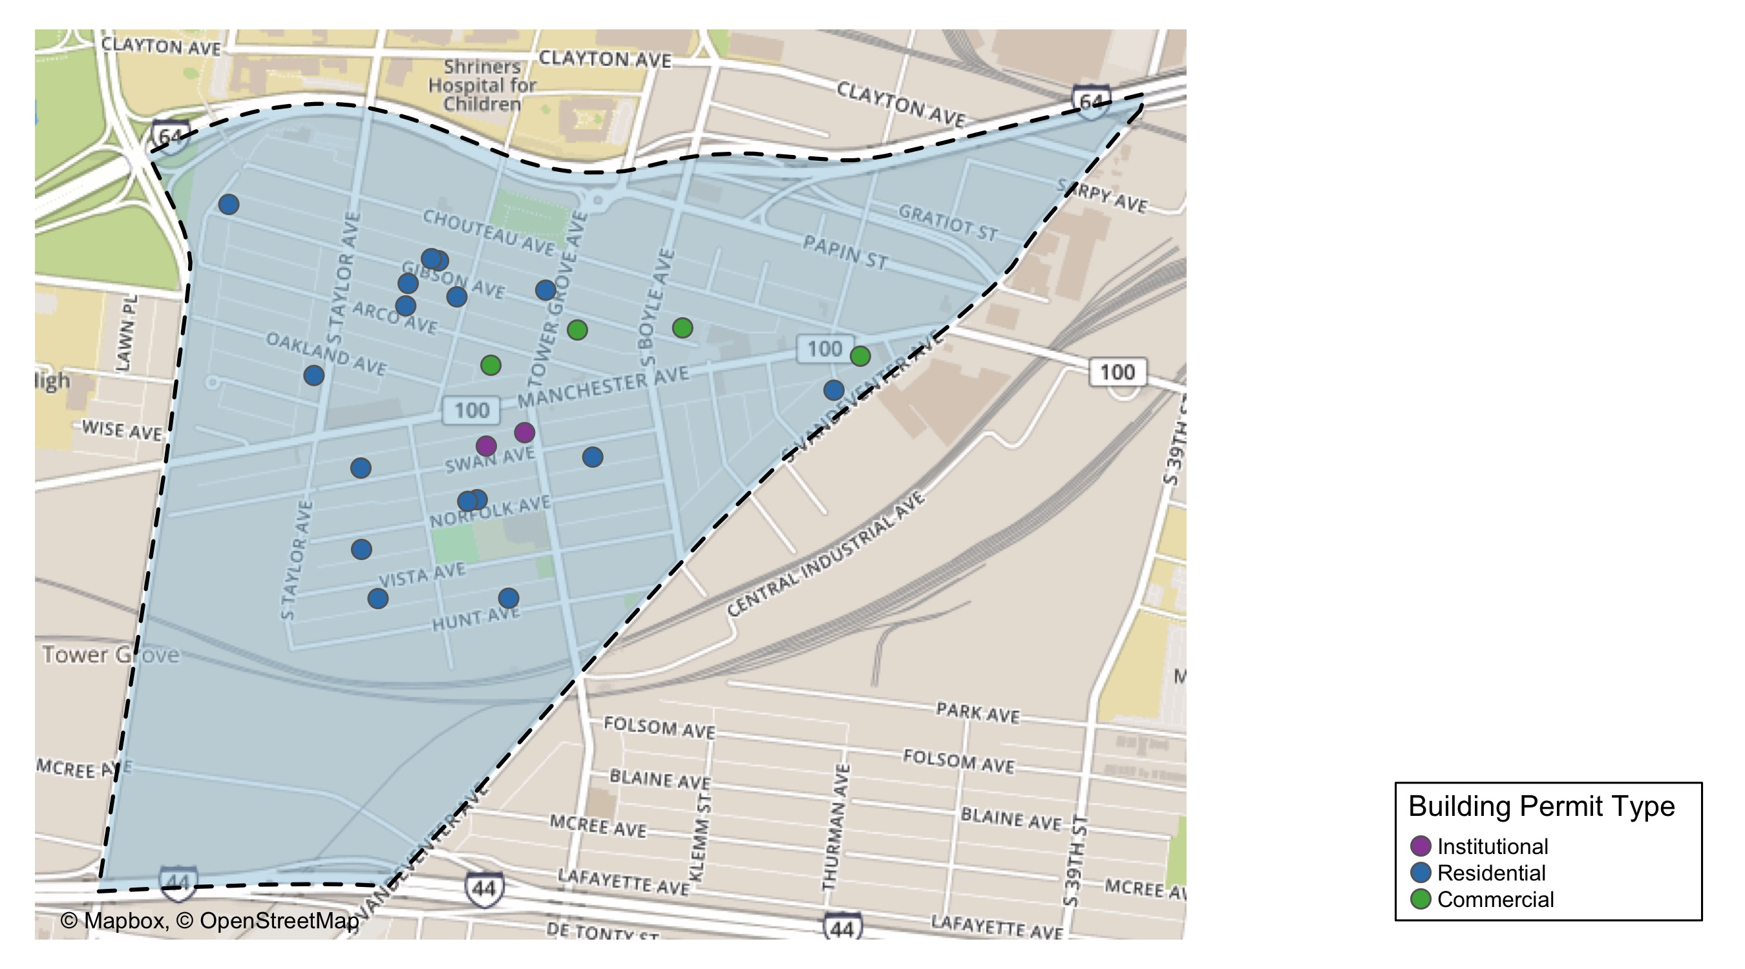
Forest Park Southeast

Slide 12
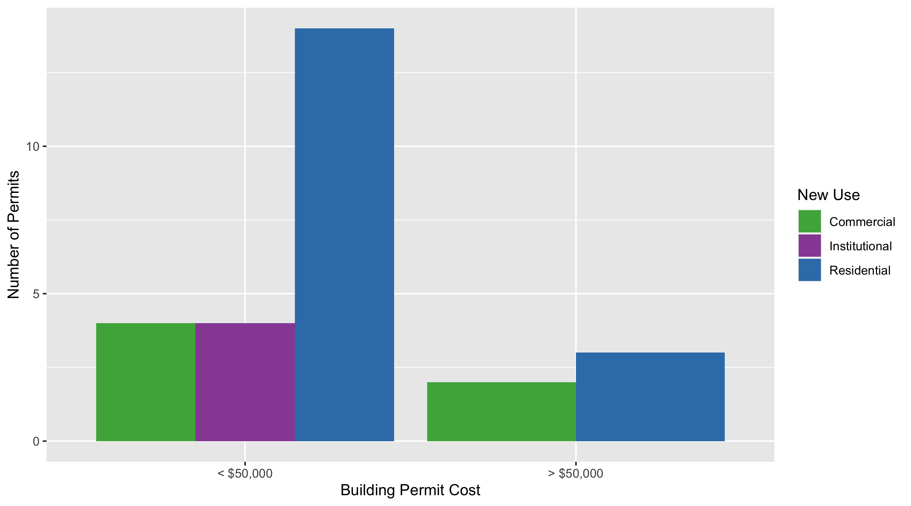
Forest Park Southeast Permit Use Breakdown

Slide 13
Forest Park Southeast
Quarter 2, 2020 | Quarter 2, 2020 | Quarter 2, 2020 | Quarter 2, 2020
Permit Use | Average Cost | # of Permits | Total Value of Permits
Commercial | $61,500 | 6 | $369,000
Industrial | $0 | 0 | $0
Institutional | $6,050 | 4 | $24,200
Residential | $23,603 | 17 | $401,255
Quarter 2 2019 | Quarter 2 2019 | Quarter 2 2019 | Quarter 2 2019
Permit Use | Average Cost | # of Permits | Total Value of Permits
Commercial | $87,600 | 9 | $788,400
Industrial | $0 | 0 | $0
Institutional | $26,656 | 8 | $213,250
Residential | $41,987 | 18 | $755,770

Slide 14
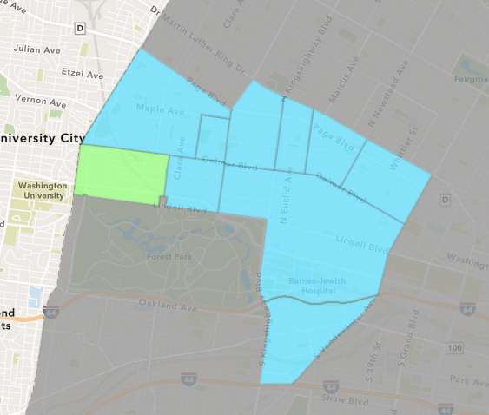
Skinker DeBaliviere
Quarter 2 , 2020 Neighborhood Cost Breakdown
Mean: $2,077,444
Median: $20,700
Range: $1,000 - $33,603,927

Slide 15
Skinker DeBaliviere: Summary Notes
29 building permits in Quarter 2, 2020
107.14% change compared to Quarter 2, 2019 (14 total building permits)
$2,077,444: Average building permit cost in Quarter 2, 2020
17221.52% change compared to Quarter 2, 2019 ($11,993)

Slide 16
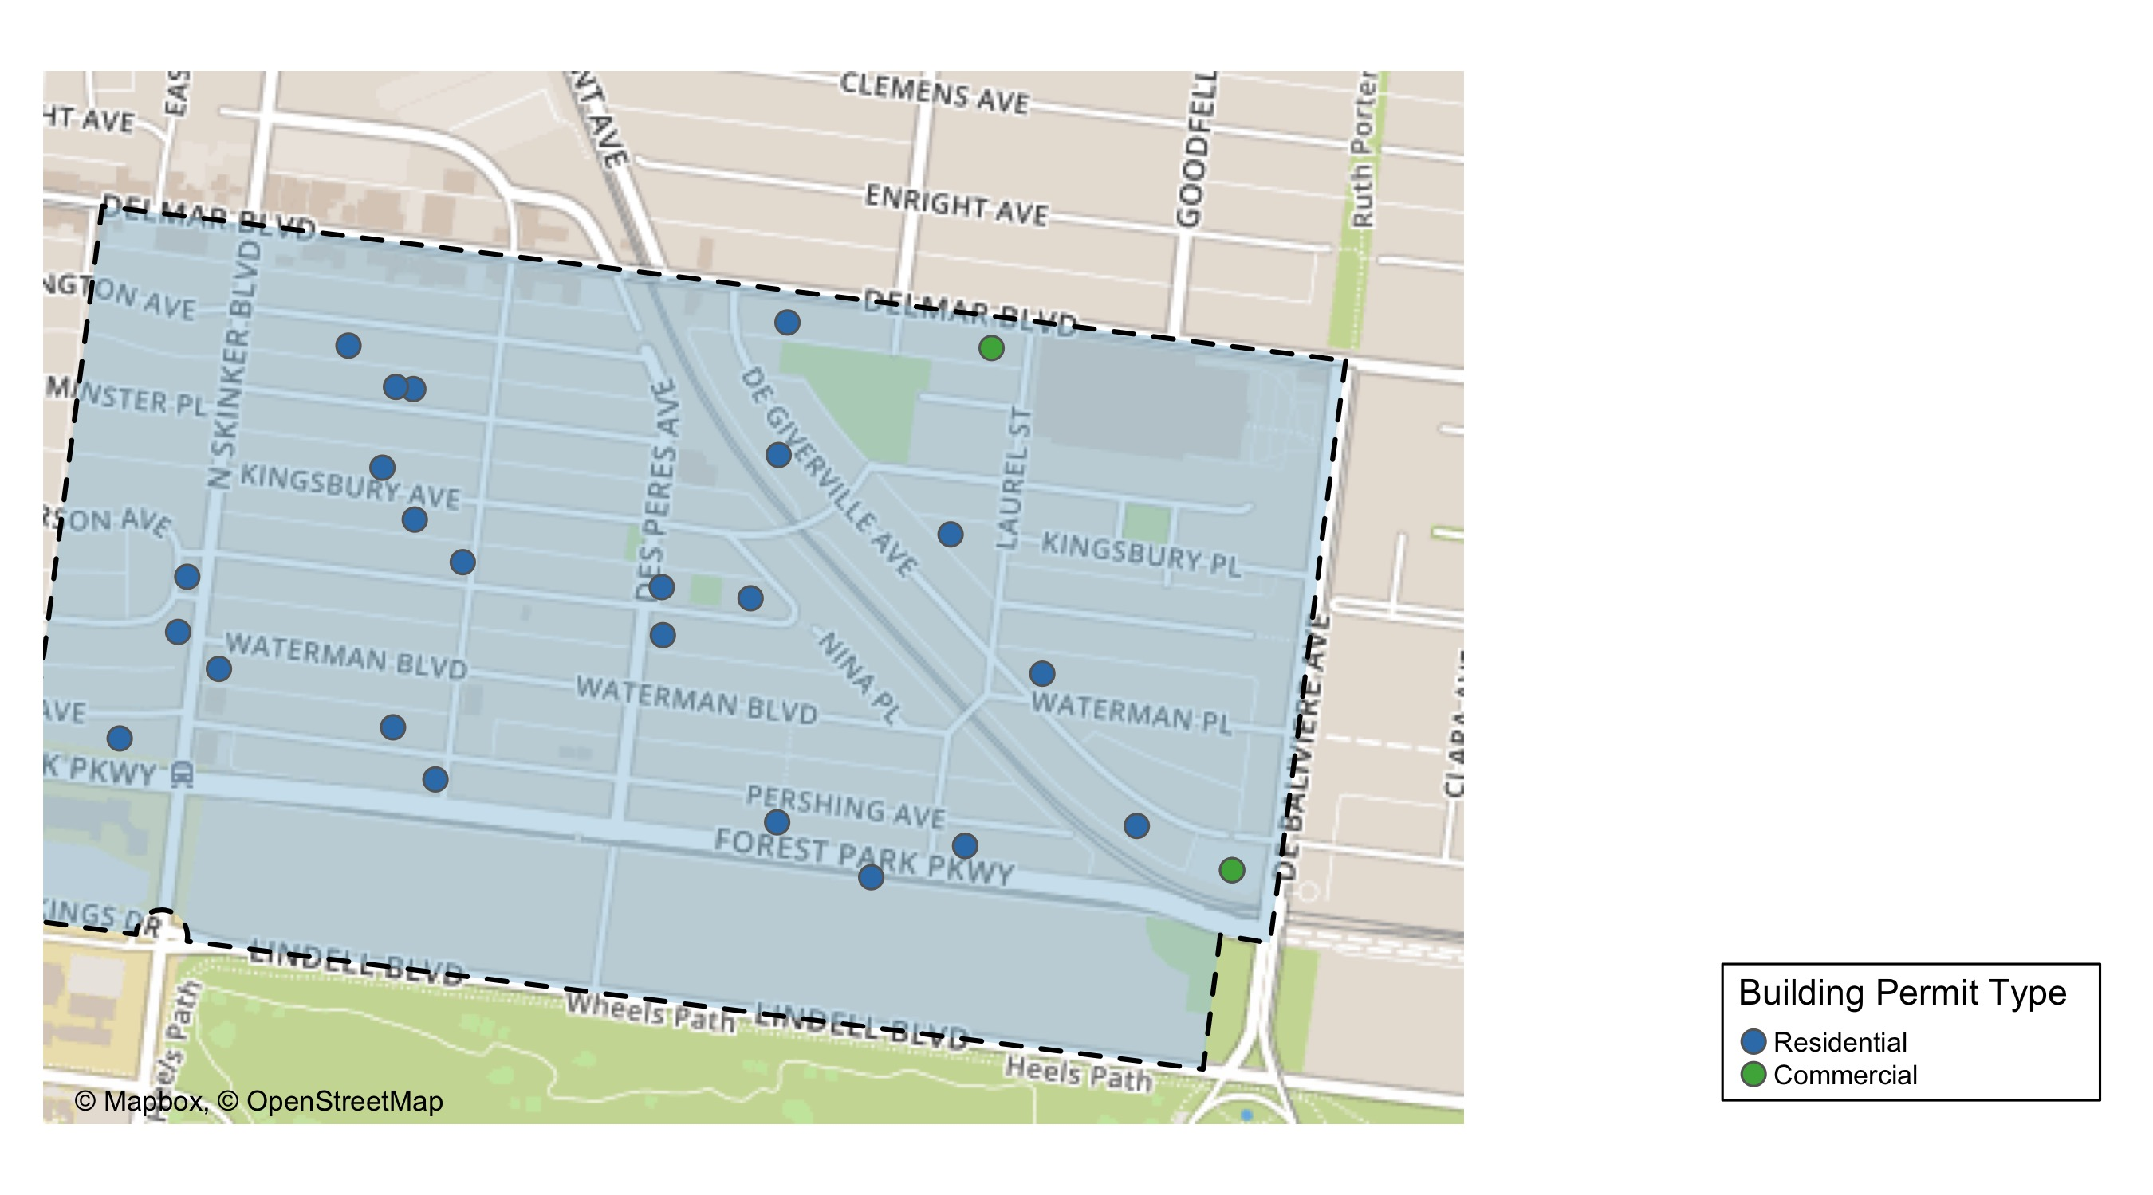
Skinker DeBaliviere

Slide 17
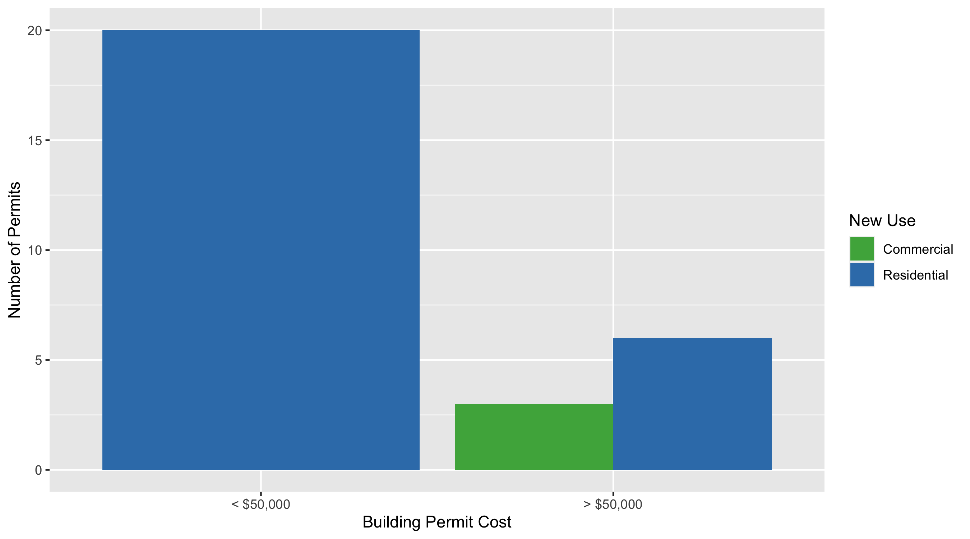
Skinker DeBaliviere Permit Use Breakdown

Slide 18
Skinker DeBaliviere
Quarter 2, 2020 | Quarter 2, 2020 | Quarter 2, 2020 | Quarter 2, 2020
Permit Use | Average Cost | # of Permits | Total Value of Permits
Commercial | $18,796,603 | 3 | $56,389,808
Industrial | $0 | 0 | $0
Institutional | $0 | 0 | $0
Residential | $148,310 | 26 | $3,856,055
Quarter 2 2019 | Quarter 2 2019 | Quarter 2 2019 | Quarter 2 2019
Permit Use | Average Cost | # of Permits | Total Value of Permits
Commercial | $7,776 | 3 | $23,329
Industrial | $0 | 0 | $0
Institutional | $0 | 0 | $0
Residential | $13,144 | 11 | $144,579

Slide 19
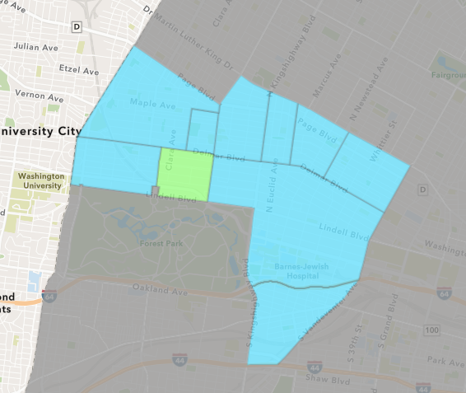
DeBaliviere Place
Quarter 2 , 2020 Neighborhood Cost Breakdown
Mean: $242,790
Median: $29,456
Range: $600 - $2,435,000

Slide 20
DeBaliviere Place: Summary Notes
14 building permits in Quarter 2, 2020
0.00% change compared to Quarter 2, 2019 (14 total building permits)
$242,790: Average building permit cost in Quarter 2, 2020
262.33% change compared to Quarter 2, 2019 ($67,009)

Slide 21
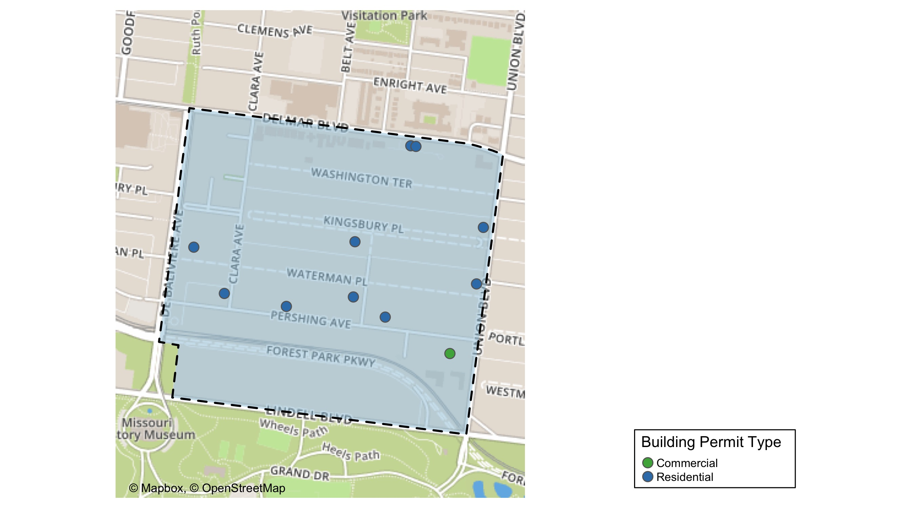
DeBaliviere Place

Slide 22
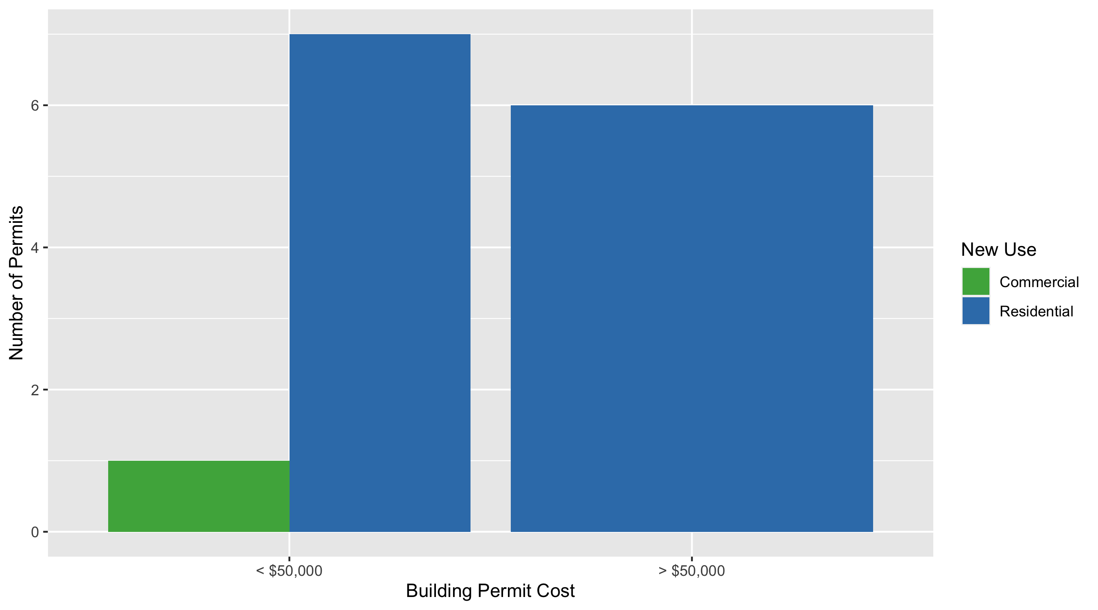
DeBaliviere Place Permit Use Breakdown

Slide 23
DeBaliviere Place
Quarter 2, 2020 | Quarter 2, 2020 | Quarter 2, 2020 | Quarter 2, 2020
Permit Use | Average Cost | # of Permits | Total Value of Permits
Commercial | $25,000 | 1 | $25,000
Industrial | $0 | 0 | $0
Institutional | $0 | 0 | $0
Residential | $259,543 | 13 | $3,374,060
Quarter 2 2019 | Quarter 2 2019 | Quarter 2 2019 | Quarter 2 2019
Permit Use | Average Cost | # of Permits | Total Value of Permits
Commercial | $15,000 | 1 | $15,000
Industrial | $0 | 0 | $0
Institutional | $0 | 0 | $0
Residential | $71,010 | 13 | $923,124

Slide 24
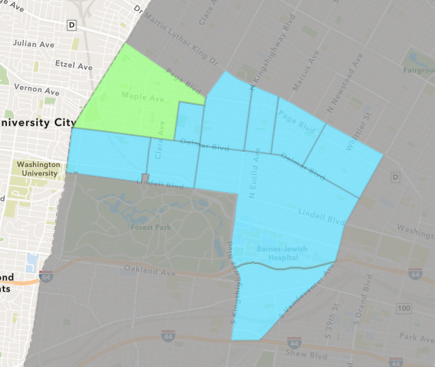
West End
Quarter 2 , 2020 Neighborhood Cost Breakdown
Mean: $64,981
Median: $14,500
Range: $3,600 - $325,000

Slide 25
West End: Summary Notes
8 building permits in Quarter 2, 2020
0.00% change compared to Quarter 2, 2019 (8 total building permits)
$64,981: Average building permit cost in Quarter 2, 2020
352.04% change compared to Quarter 2, 2019 ($14,375)

Slide 26
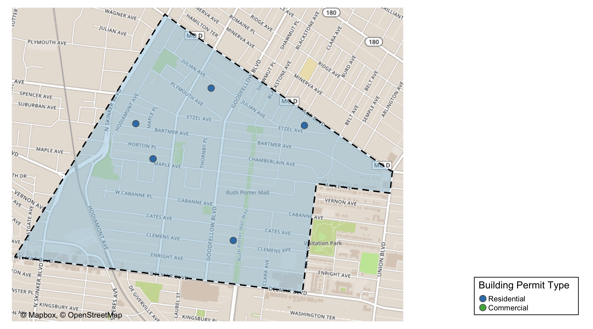
West End

Slide 27
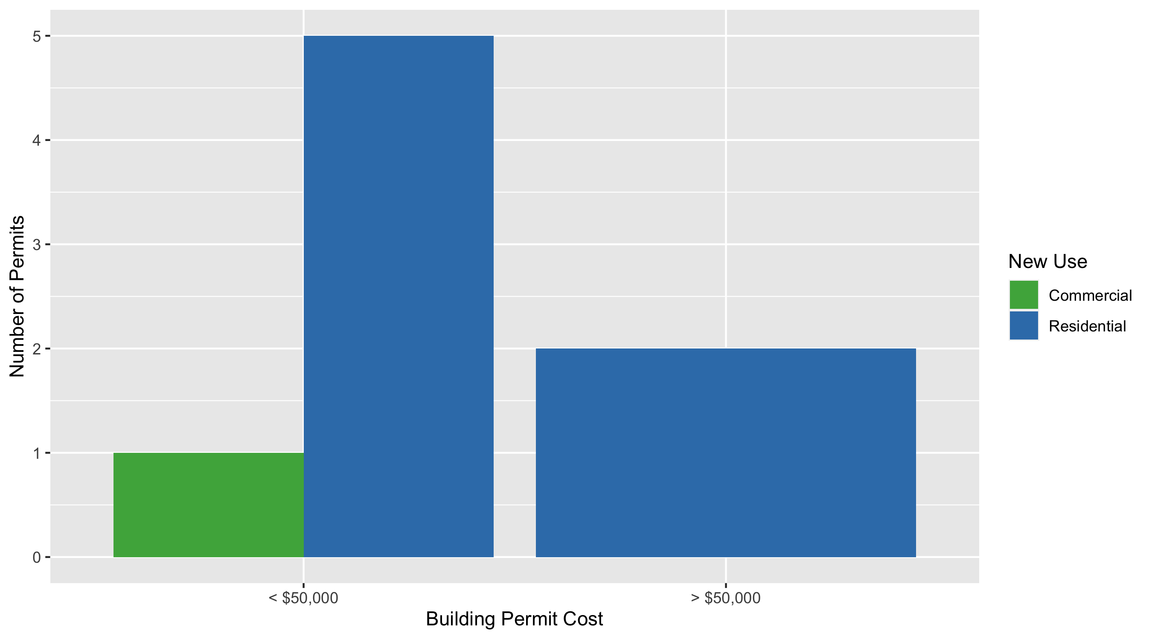
West End Permit Use Breakdown

Slide 28
West End
Quarter 2, 2020 | Quarter 2, 2020 | Quarter 2, 2020 | Quarter 2, 2020
Permit Use | Average Cost | # of Permits | Total Value of Permits
Commercial | $15,000 | 1 | $15,000
Industrial | $0 | 0 | $0
Institutional | $0 | 0 | $0
Residential | $72,121 | 7 | $504,850
Quarter 2 2019 | Quarter 2 2019 | Quarter 2 2019 | Quarter 2 2019
Permit Use | Average Cost | # of Permits | Total Value of Permits
Commercial | $25,000 | 1 | $25,000
Industrial | $0 | 0 | $0
Institutional | $40,000 | 1 | $40,000
Residential | $8,333 | 6 | $50,000

Slide 29
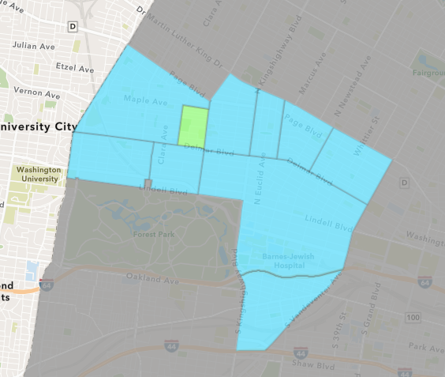
Visitation Park
Quarter 2 , 2020 Neighborhood Cost Breakdown
Mean: $7,250
Median: $7,250
Range: $7,250 - $7,250

Slide 30
Visitation Park: Summary Notes
1 building permits in Quarter 2, 2020
Infinite change compared to Quarter 2, 2019 (0 total building permits)
$7,250: Average building permit cost in Quarter 2, 2020
Infinite change compared to Quarter 2, 2019 ($0)

Slide 31
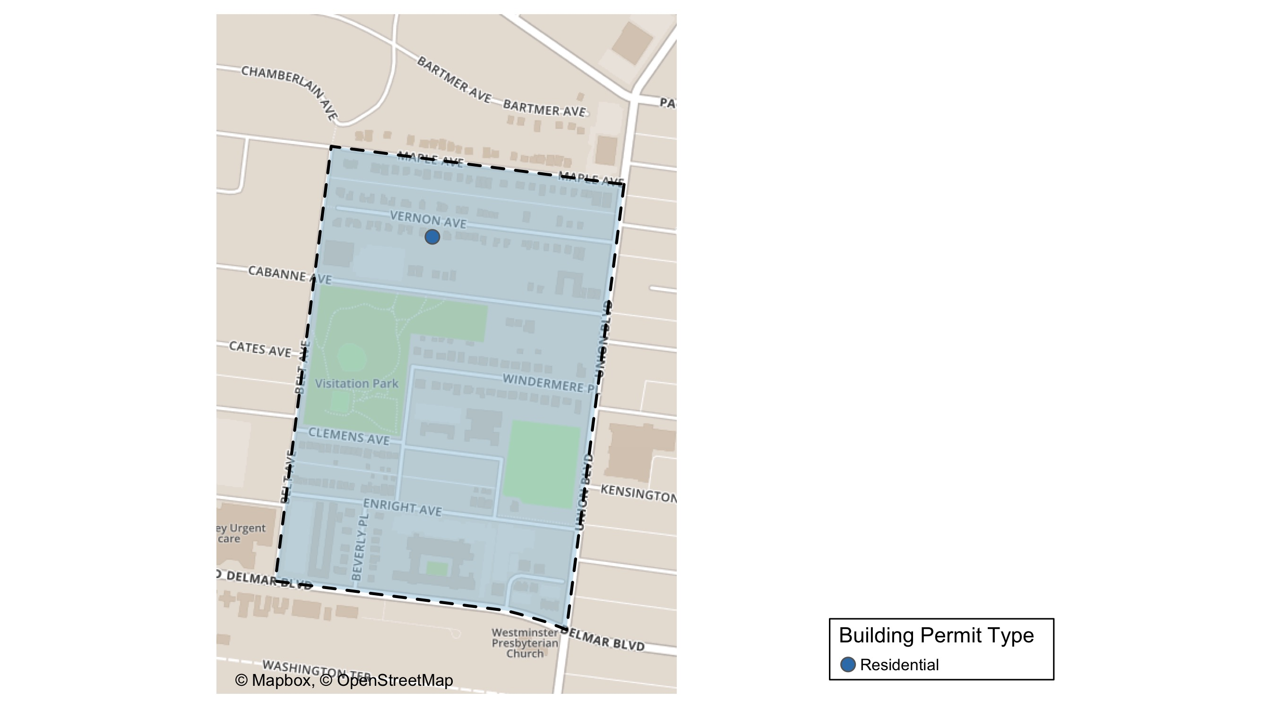
Visitation Park

Slide 32
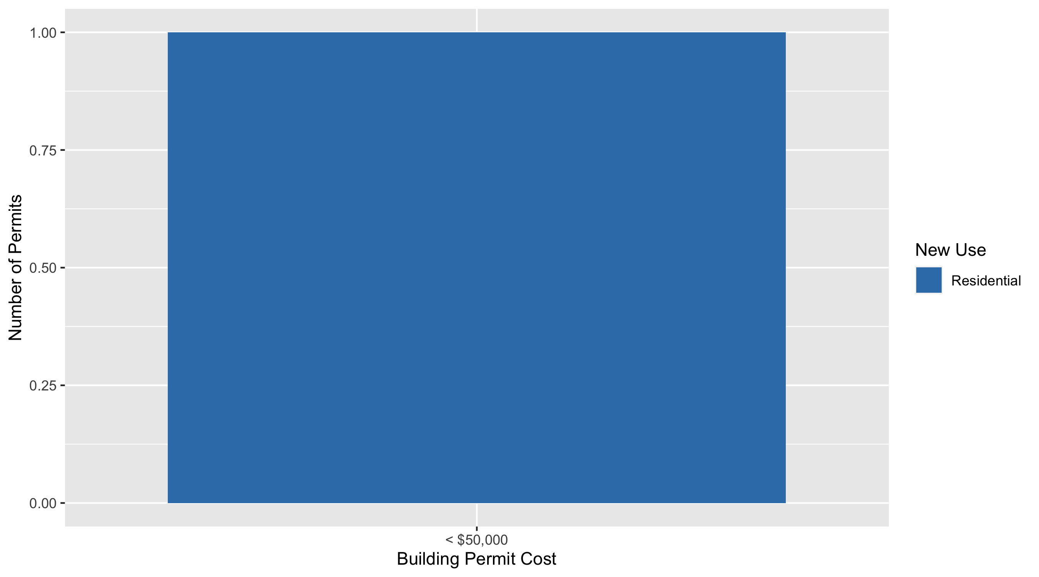
Visitation Park Permit Use Breakdown

Slide 33
Visitation Park Permit Breakdown
2020 | 2020 | 2020 | 2020
Permit Use | Average Cost | # of Permits | Total Value of Permits
Commercial | 0 | 0 | 0
Industrial | 0 | 0 | 0
Institutional | 0 | 0 | 0
Residential | 7250 | 1 | 7250

Slide 34
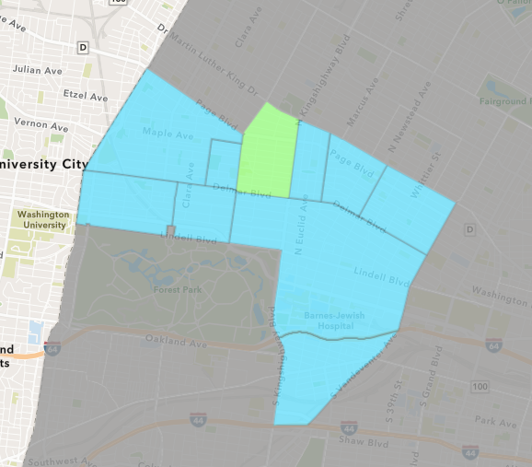
Academy
Quarter 2 , 2020 Neighborhood Cost Breakdown
Mean: $30,377
Median: $3,500
Range: $700 - $150,000

Slide 35
Academy: Summary Notes
11 building permits in Quarter 2, 2020
0.00% change compared to Quarter 2, 2019 (11 total building permits)
$30,377: Average building permit cost in Quarter 2, 2020
-46.58% change compared to Quarter 2, 2019 ($56,864)

Slide 36
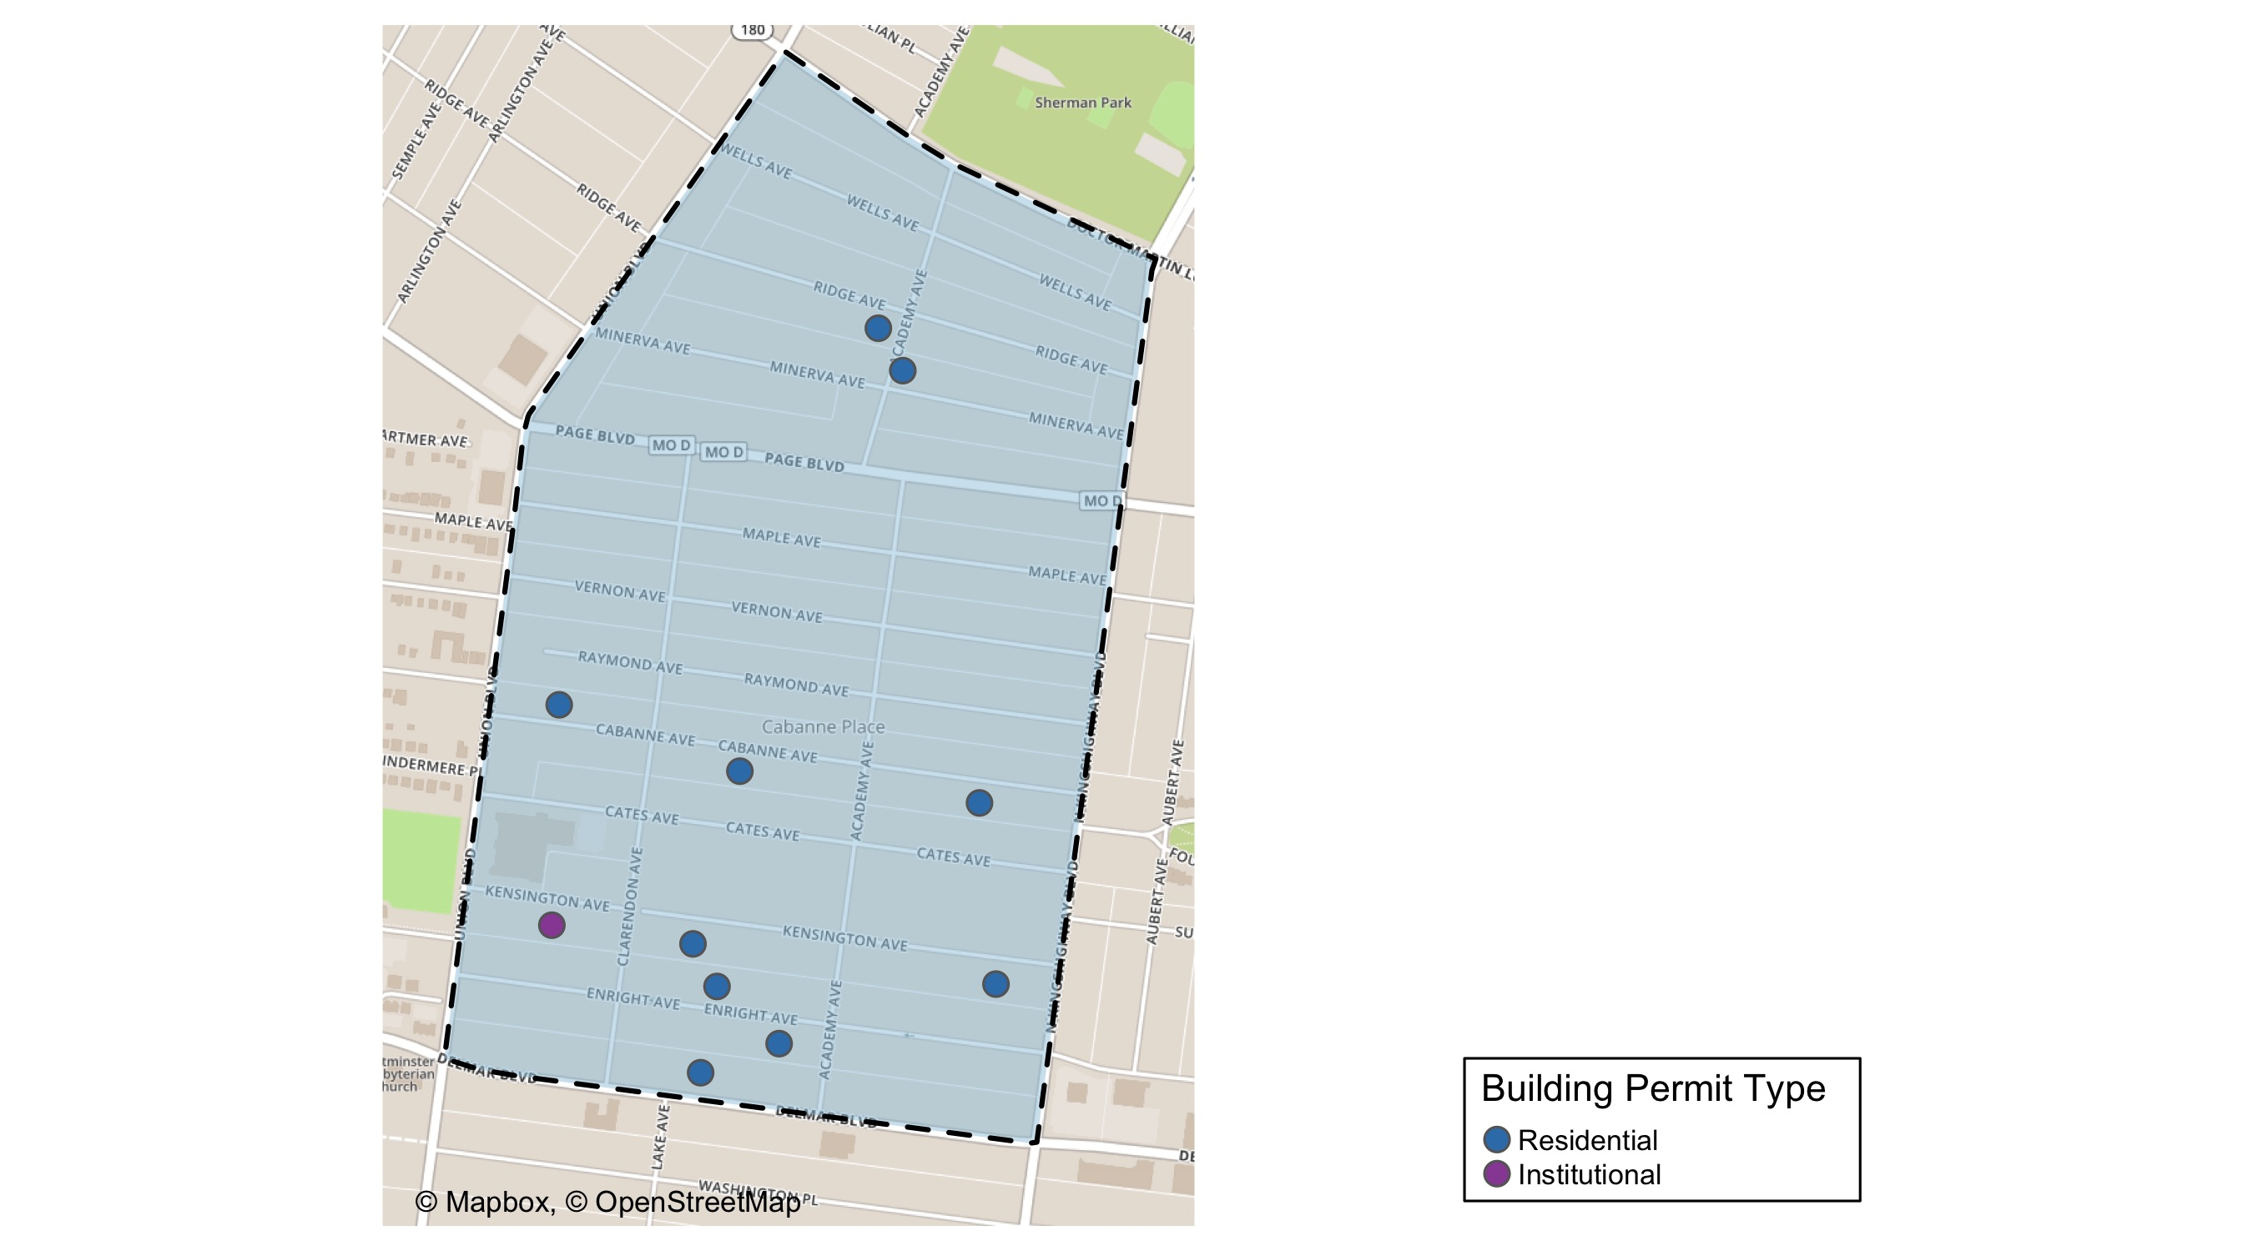
Academy

Slide 37
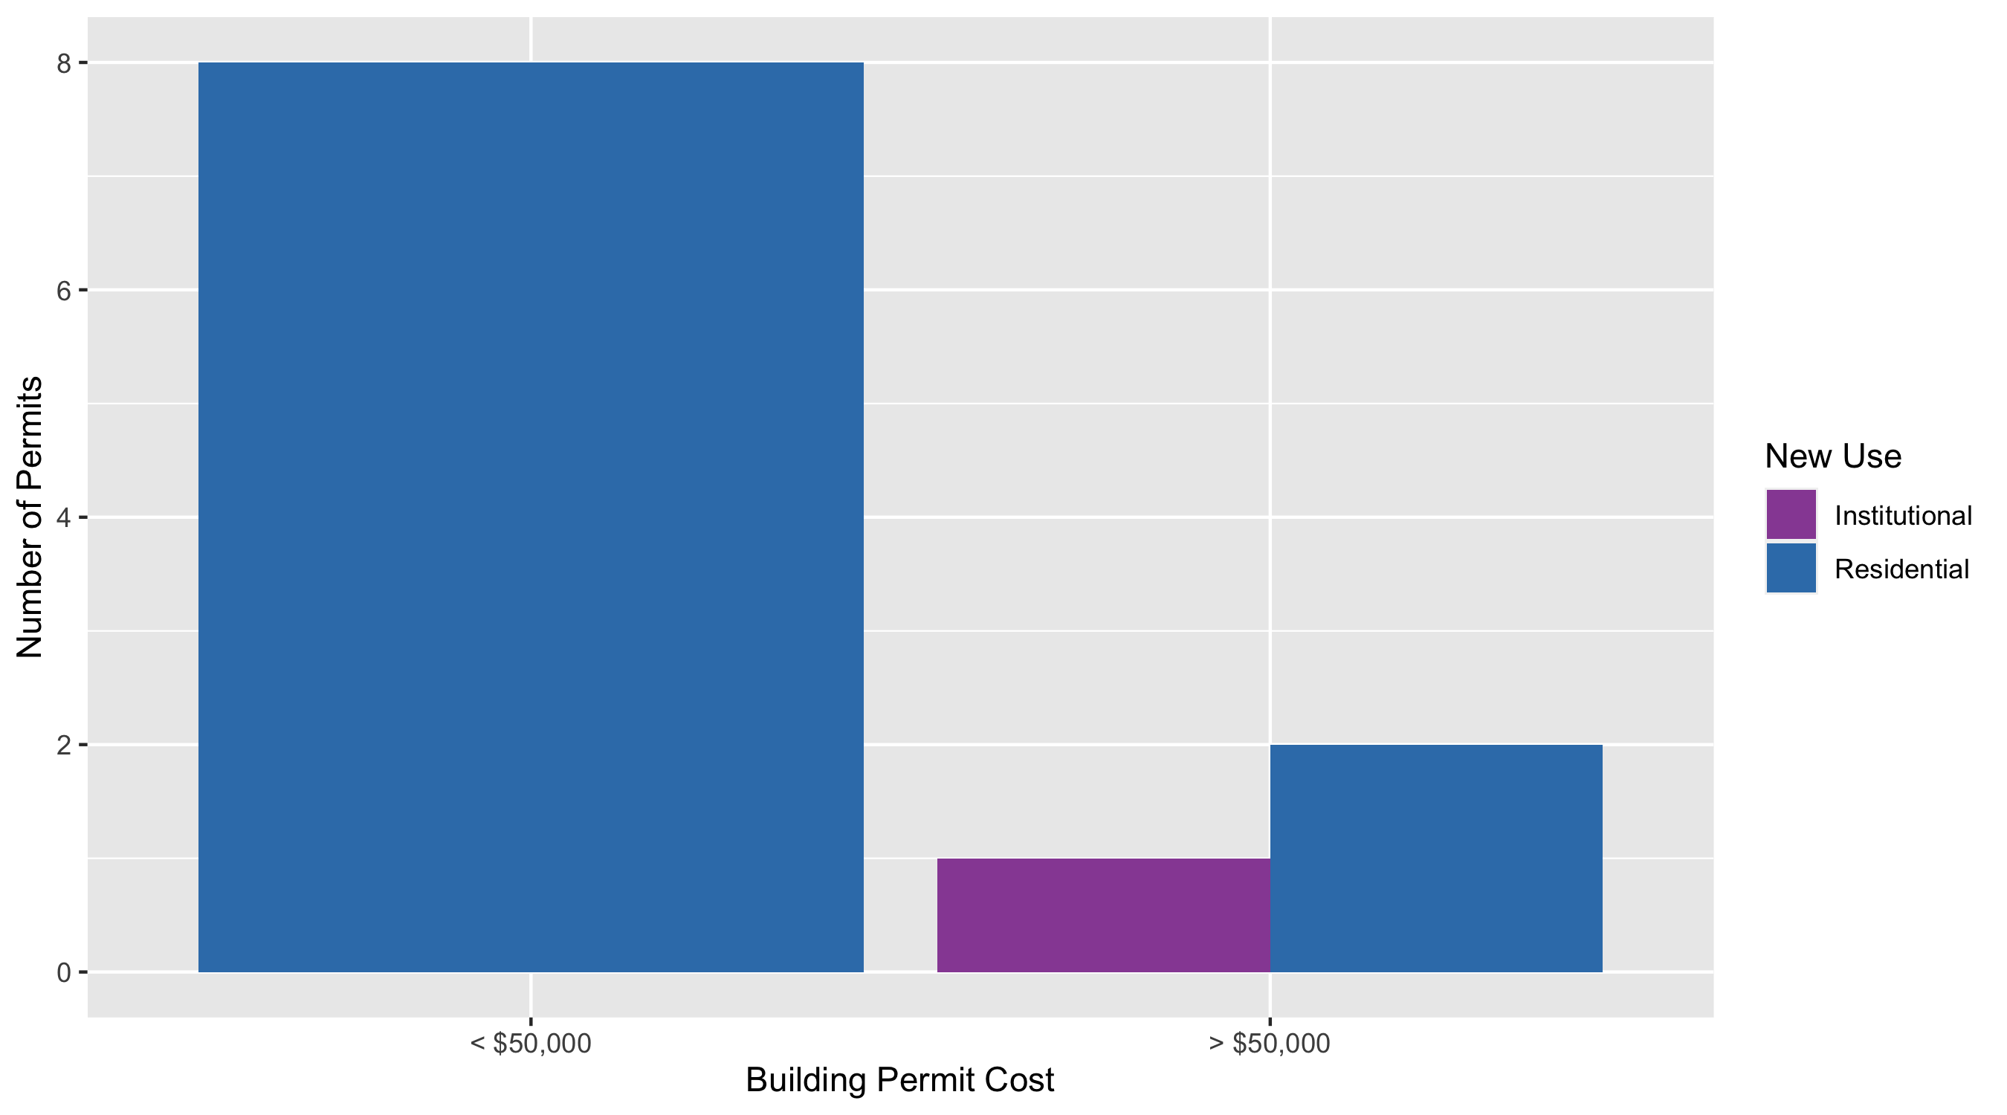
Academy Permit Use Breakdown

Slide 38
Academy
Quarter 2, 2020 | Quarter 2, 2020 | Quarter 2, 2020 | Quarter 2, 2020
Permit Use | Average Cost | # of Permits | Total Value of Permits
Commercial | $0 | 0 | $0
Industrial | $0 | 0 | $0
Institutional | $50,000 | 1 | $50,000
Residential | $28,415 | 10 | $284,150
Quarter 2 2019 | Quarter 2 2019 | Quarter 2 2019 | Quarter 2 2019
Permit Use | Average Cost | # of Permits | Total Value of Permits
Commercial | $0 | 0 | $0
Industrial | $0 | 0 | $0
Institutional | $7,000 | 1 | $7,000
Residential | $61,850 | 10 | $618,500

Slide 39
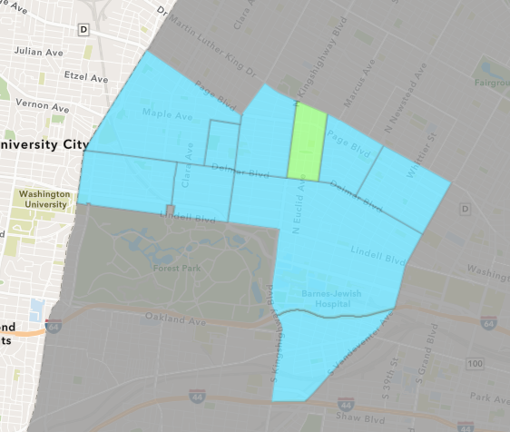
Fountain Park
Quarter 2 , 2020 Neighborhood Cost Breakdown
Mean: $26,625
Median: $10,250
Range: $1,000 - $85,000

Slide 40
Fountain Park: Summary Notes
4 building permits in Quarter 2, 2020
33.33% change compared to Quarter 2, 2019 (3 total building permits)
$26,625: Average building permit cost in Quarter 2, 2020
-39.94% change compared to Quarter 2, 2019 ($44,333)

Slide 41
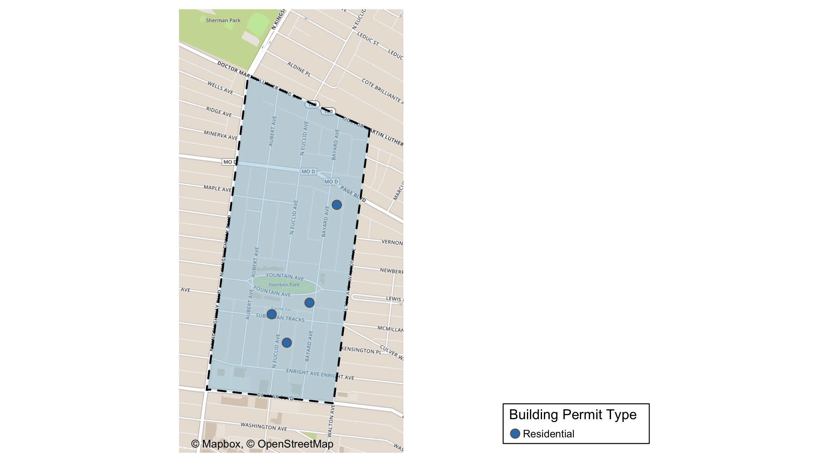
Fountain Park

Slide 42
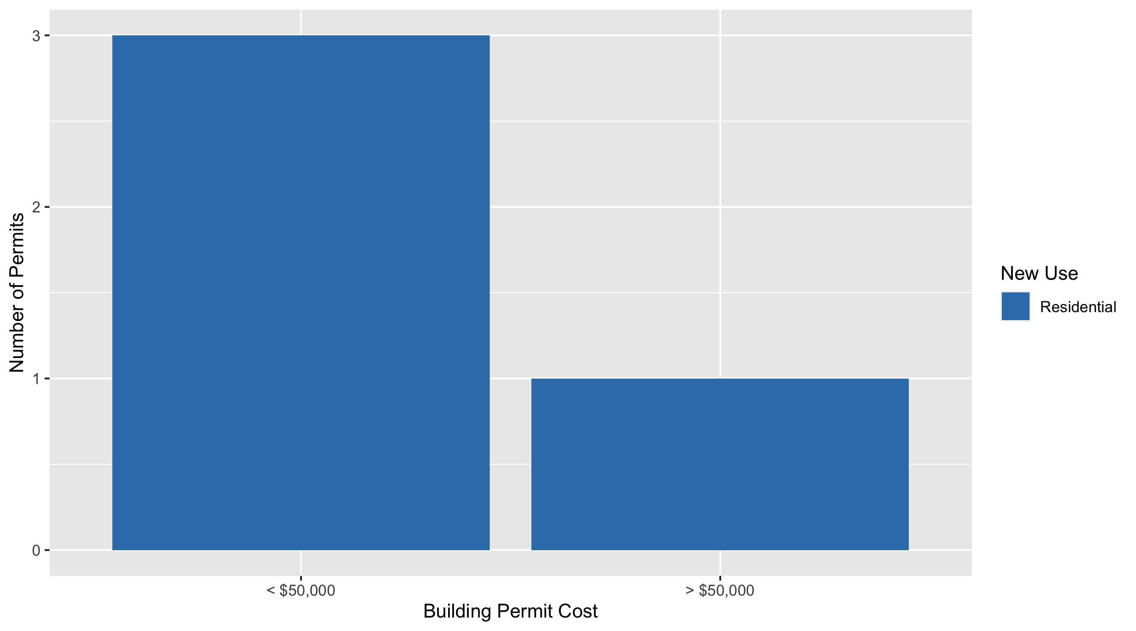
Fountain Park Permit Use Breakdown

Slide 43
Fountain Park
Quarter 2, 2020 | Quarter 2, 2020 | Quarter 2, 2020 | Quarter 2, 2020
Permit Use | Average Cost | # of Permits | Total Value of Permits
Commercial | $0 | 0 | $0
Industrial | $0 | 0 | $0
Institutional | $0 | 0 | $0
Residential | $26,625 | 4 | $106,500
Quarter 2 2019 | Quarter 2 2019 | Quarter 2 2019 | Quarter 2 2019
Permit Use | Average Cost | # of Permits | Total Value of Permits
Commercial | $0 | 0 | $0
Industrial | $0 | 0 | $0
Institutional | $0 | 0 | $0
Residential | $44,333 | 3 | $133,000

Slide 44
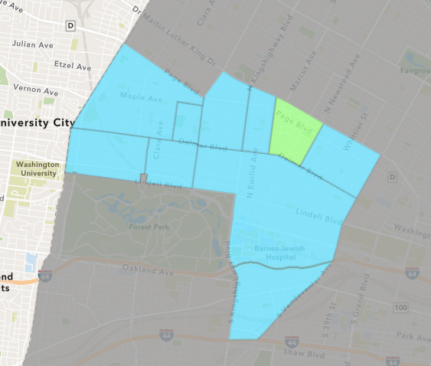
Lewis Place
Quarter 2 , 2020 Neighborhood Cost Breakdown
Mean: $233
Median: $100
Range: $100 - $500

Slide 45
Lewis Place: Summary Notes
3 building permits in Quarter 2, 2020
200.00% change compared to Quarter 2, 2019 (1 total building permits)
$233: Average building permit cost in Quarter 2, 2020
-98.44% change compared to Quarter 2, 2019 ($15,000)

Slide 46
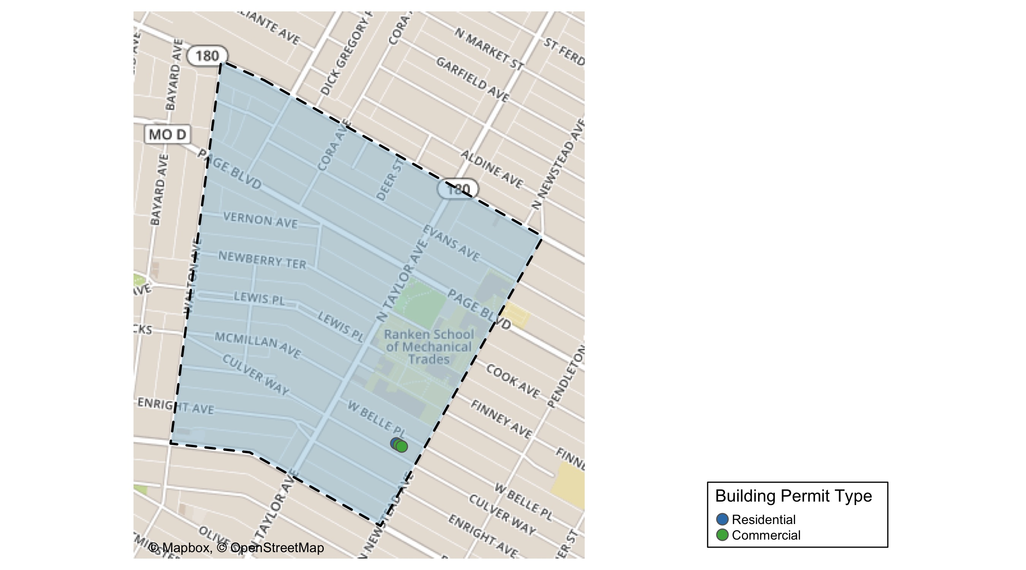
Lewis Place

Slide 47
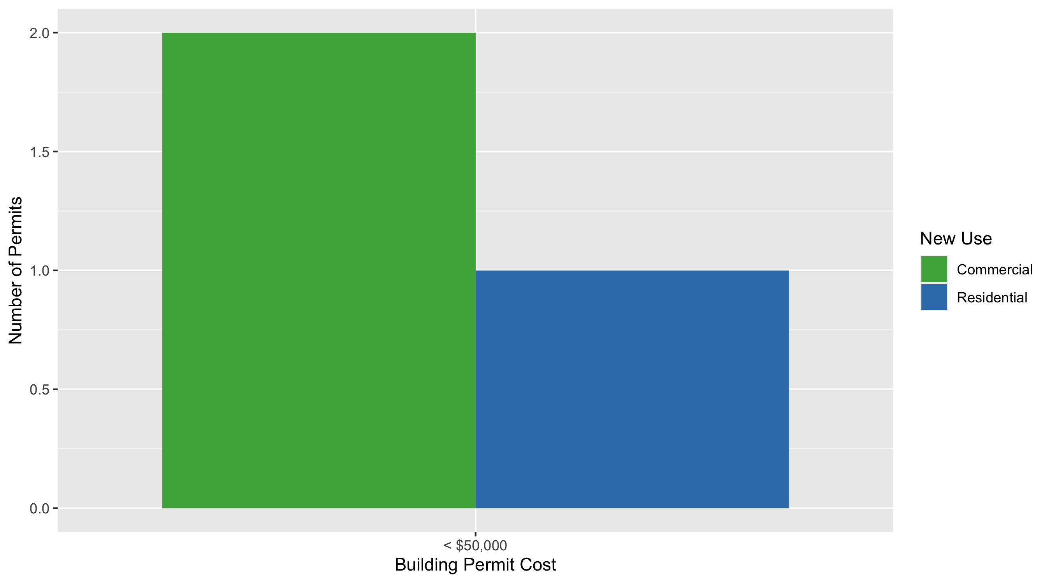
Lewis Place Permit Use Breakdown

Slide 48
Lewis Place
Quarter 2, 2020 | Quarter 2, 2020 | Quarter 2, 2020 | Quarter 2, 2020
Permit Use | Average Cost | # of Permits | Total Value of Permits
Commercial | $100 | 2 | $200
Industrial | $0 | 0 | $0
Institutional | $0 | 0 | $0
Residential | $500 | 1 | $500
Quarter 2 2019 | Quarter 2 2019 | Quarter 2 2019 | Quarter 2 2019
Permit Use | Average Cost | # of Permits | Total Value of Permits
Commercial | $15,000 | 1 | $15,000
Industrial | $0 | 0 | $0
Institutional | $0 | 0 | $0
Residential | $0 | 0 | $0

Slide 49
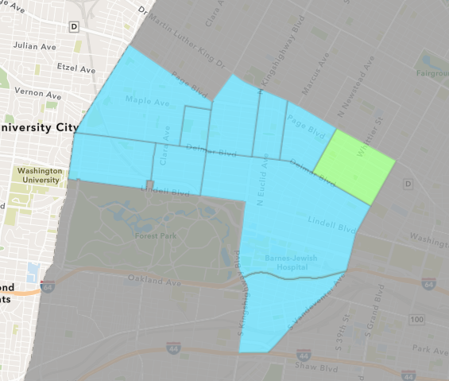
Vandeventer
Quarter 2 , 2020 Neighborhood Cost Breakdown
Mean: $36,925
Median: $11,100
Range: $500 - $125,000

Slide 50
Vandeventer: Summary Notes
4 building permits in Quarter 2, 2020
-63.64% change compared to Quarter 2, 2019 (11 total building permits)
$36,925: Average building permit cost in Quarter 2, 2020
93.86% change compared to Quarter 2, 2019 ($19,047)

Slide 51
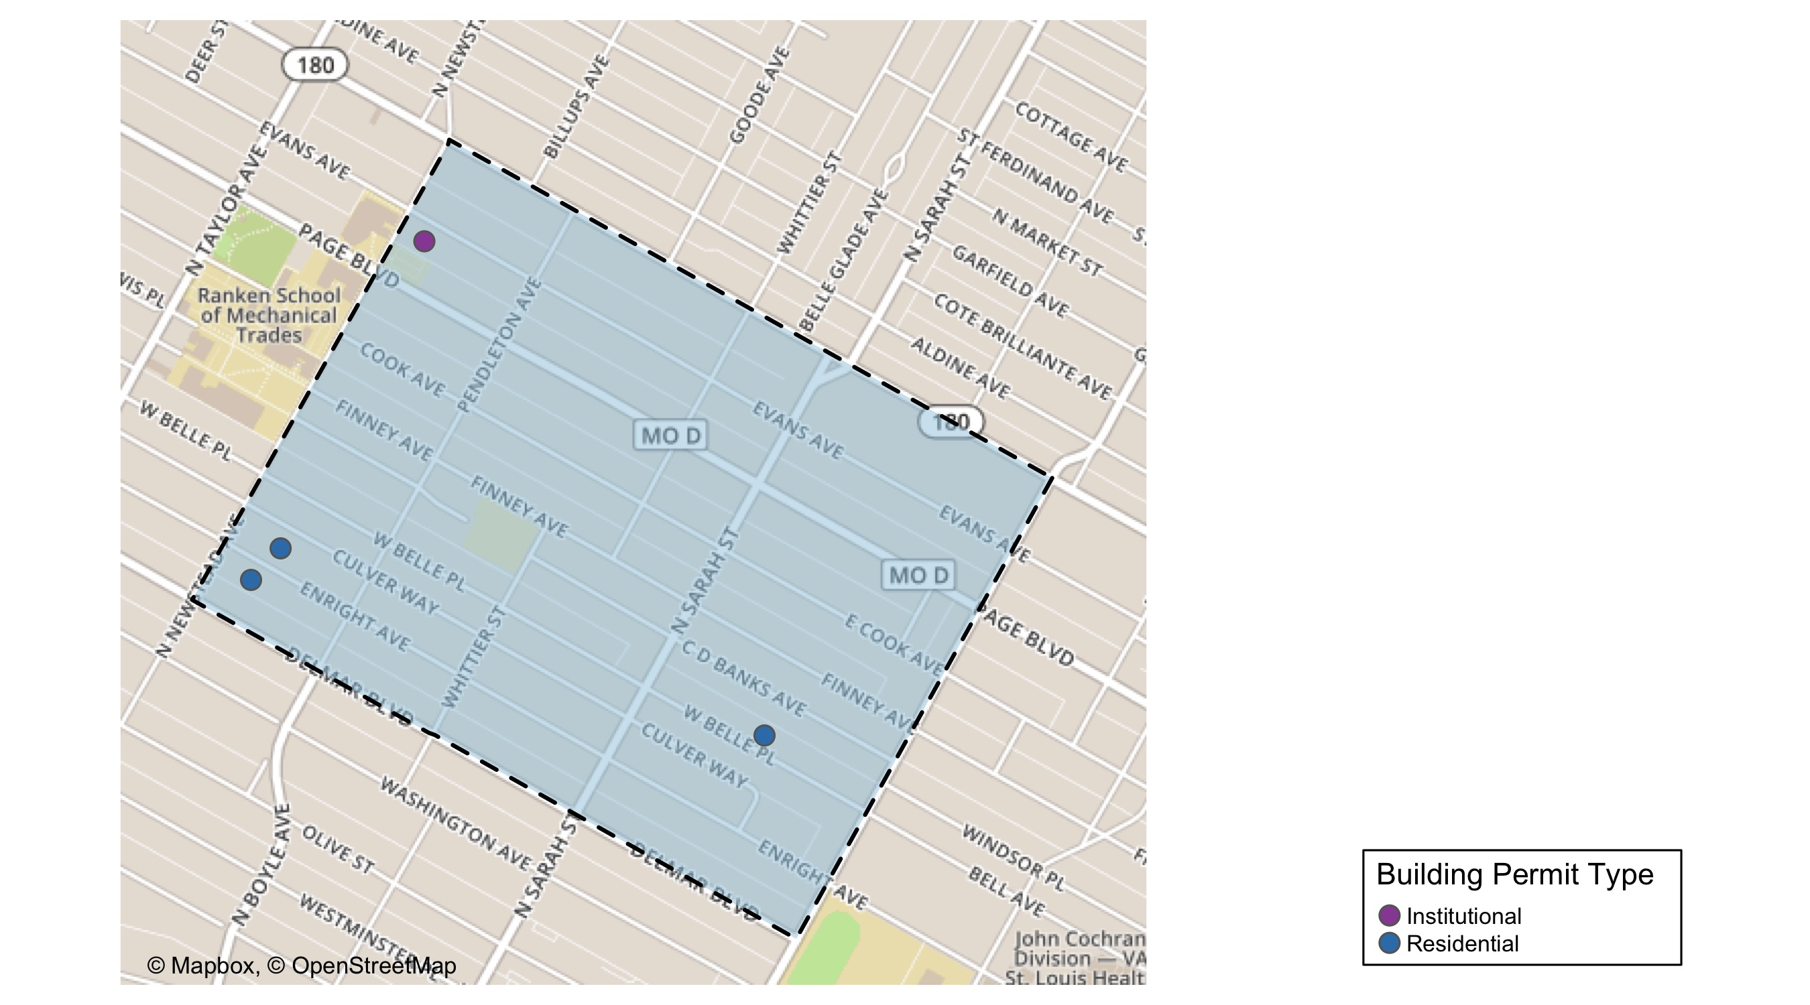
Vandeventer

Slide 52
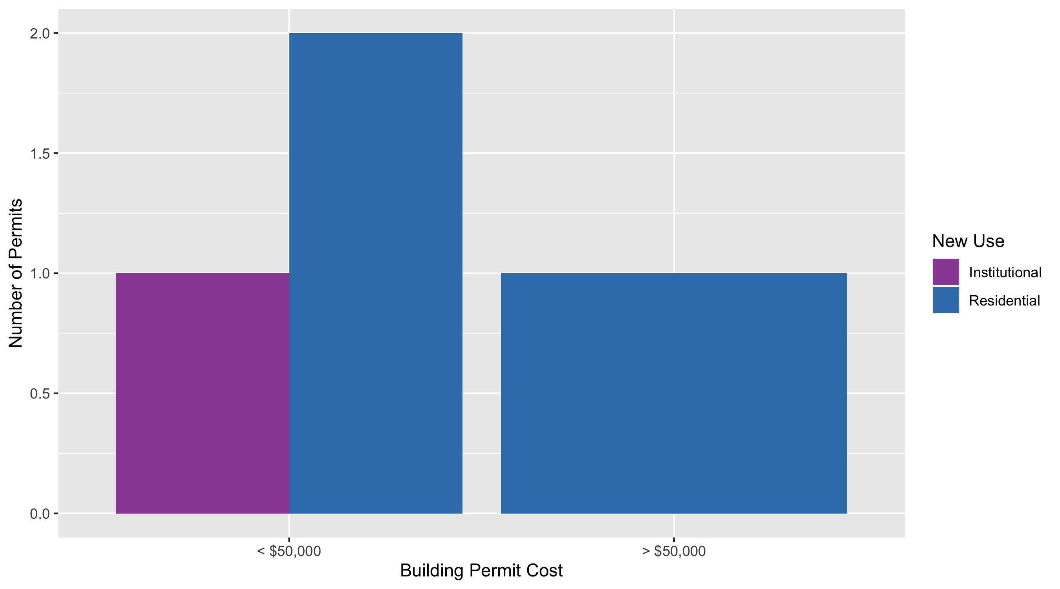
Vandeventer Permit Use Breakdown

Slide 53
Vandeventer
Quarter 2, 2020 | Quarter 2, 2020 | Quarter 2, 2020 | Quarter 2, 2020
Permit Use | Average Cost | # of Permits | Total Value of Permits
Commercial | $0 | 0 | $0
Industrial | $0 | 0 | $0
Institutional | $500 | 1 | $500
Residential | $49,067 | 3 | $147,200
Quarter 2 2019 | Quarter 2 2019 | Quarter 2 2019 | Quarter 2 2019
Permit Use | Average Cost | # of Permits | Total Value of Permits
Commercial | $0 | 0 | $0
Industrial | $0 | 0 | $0
Institutional | $0 | 0 | $0
Residential | $19,047 | 11 | $209,522

Slide 54
Additional Notes
Data retreived from https://www.stlouis-mo.gov/data/
Building permits with a cost of $0 were dropped
Building permits that were cancelled were dropped
Infinite change indicates 0 permits in the current or previous time period/comparison month so there was a overall increase or decrease

